Slide 1
RAT Removal Lab
Please Note: It is highly recommended to have completed the Backdoor Removal Lab prior to this lab.

Slide 2
RAT Removal Lab
Materials needed
Kali Linux Virtual Machine
Windows 7 Virtual Machine
Software tool used (from Kali Linux)
Metasploit Framework
Note: This lab will attempt to remove a persistence script that is already running on the Windows 7 machine

Slide 3
Objectives Covered
Security+ Objectives (SY0-501)
Objective 1.1 – Given a scenario, analyze indicators of compromise and determine the type of malware
Backdoor
DHS CAE Units
CTH – Describe different types of attacks and their characteristics

Slide 4
What is a RAT?
A Remote Access Trojan (RAT) is a tool that allows malicious users to connect remotely to a system
Sometime referred to as a Remote Administration Tool
An ultimate backdoor
It is recommended to use the same RAT installed by the RAT/Bot Lab

Slide 5
The RAT Removal Lab
Please Note: It is highly recommended to connect to the RAT by following along with the RAT/Bot Lab!
Connect to the RAT
Shut Down the Current Session
Re-open the Backdoor
Locate the RAT
Locate all the RATs
Delete the RATs and Reboot
Try to Reconnect

Slide 6
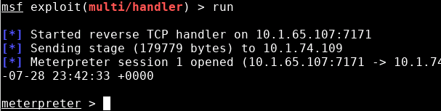
Connect to the RAT
Connect with the RAT from the Kali Linux machine
Have a backdoor session open on the Kali machine
Windows 7 machine is being controlled
It is highly recommended to have the persistence scripts from the RAT/Bot lab used for this RAT.
Open backdoor session, connected via a RAT

Slide 7
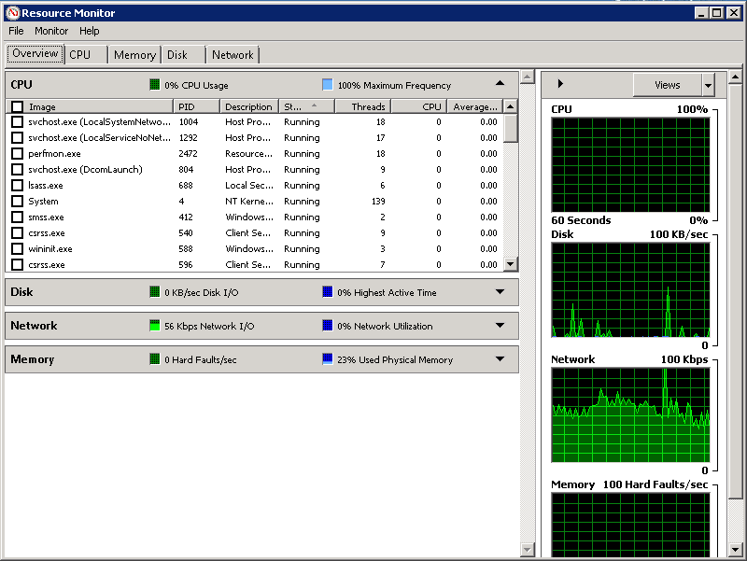
Shut Down the Current Session
In Windows, the user can search and try to kill a backdoor session just like in the Backdoor Removal Lab.
In Windows, open the Resource Monitor.
Press the Windows Start button
Search for “Resource Monitor”
Open the Resource Monitor application
Windows 7 Resource Monitor

Slide 8
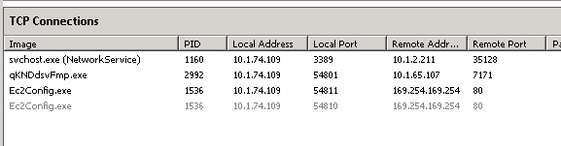
Shut Down the Current Session
In the Resource Monitor, select the Network tab
Open the TCP Connections tab
Locate the backdoor session
It should be using the remote address of the Kali machine
This should be your Kali IP Address and the port you assigned for the backdoor

Slide 9
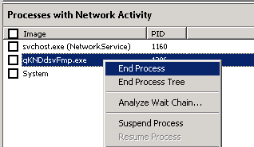
Shut Down the Current Session
Once you have the backdoor session, shut it down
Up in Processes with Network Activity
Right click on the session
Select End Process to terminate the session
You should notice on the Kali machine the session has been closed
Metasploit showing the session closed
Shutting the backdoor session down

Slide 10
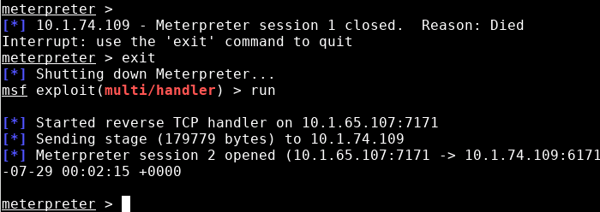
Re-open the Backdoor
In Kali, press CTRL+C to bring back up meterpreter
Use exit to quit the session
Use run to re-connect with the session
Re-connected to the backdoor
Please Note: Although the session was shut down, it was very easy for the malicious user to re-connect to the RAT

Slide 11
Locate the RAT
In Windows, stay in the Resource Monitor app
Locate the name of the RAT application
This is the name of the RAT program
Find the RAT by matching the malicious/Kali IP address and port

Slide 12
Locate the RAT
Open Windows Explorer
Press the Windows Start button
Search for “Windows Explorer”
Open Windows Explorer
Click on Computer button
In the search bar, search for the first 5 letters of the backdoor program
You should see the location of the RAT

Slide 13
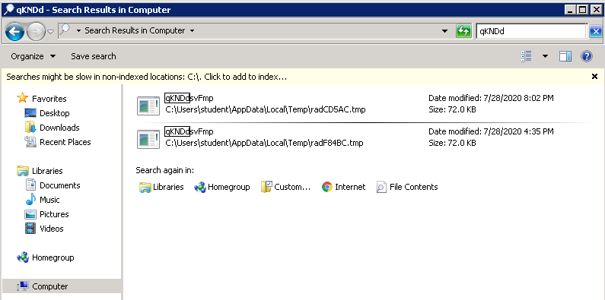
Locate the RAT
Searching for first 5 letters of the backdoor program
Location of the backdoor program

Slide 14
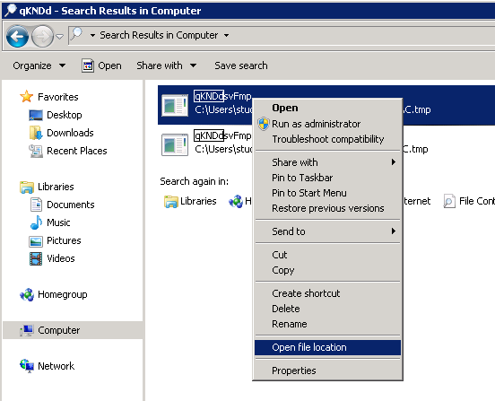
Locate the RAT
Right-click on the RAT
Select the Open file location option
This will open up the RAT’s file location
Select the Open file location

Slide 15
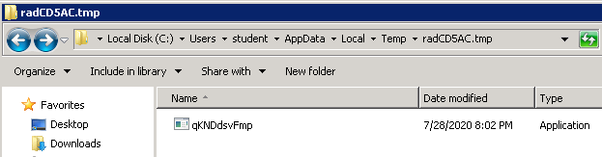
Locate all the RATs
Select one folder back
Select back one folder
This will open up the location of the RATs
Try to locate programs that look like they don’t belong, they’ll be random strings of letters

Slide 16
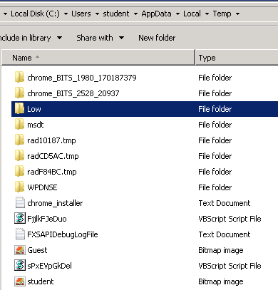
Locate all the RATs
These are the location of the backdoor scripts
These are the RATs that create the backdoor scripts. Notice they are VBScript files.

Slide 17
Delete the RATs and Reboot
Delete all of these files, especially the VBScripts files
After they are deleted, restart the Windows machine
Depending on your range, this also might require Kali to be rebooted
Please Note: You might not be able to delete a .tmp folder since there is an active backdoor inside that folder. This will erase when we restart the system.

Slide 18

Try to Reconnect
Once Windows has restarted, try to reconnect to the RAT from the Kali Linux machine
Notice that the Kali machine is not able to create a backdoor session into the Windows machine

Slide 19
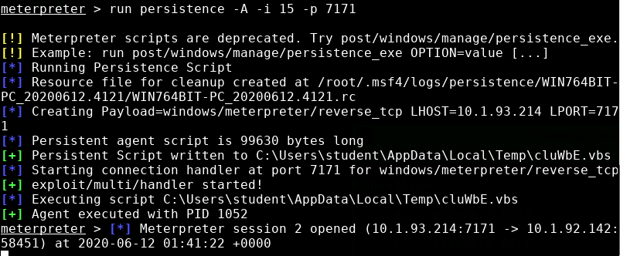
Please Note!
This is what meterpreter reads when running the persistence script from the Kali machine
Notice, it shows where it is installing the RAT

